Slide 1

Big Data Visual Analytics (CS 661)
Instructor: Soumya Dutta
Department of Computer Science and Engineering
Indian Institute of Technology Kanpur (IITK)
email: soumyad@cse.iitk.ac.in

Slide 2
Study Materials for Lecture 7
The Visualization Toolkit by Will Schroeder, Ken Martin, Bill Lorensen
Chapter 7 (Volume Rendering section)
Transfer function:
State of the Art in Transfer Functions for Direct Volume Rendering, Ljung et al., EuroVis 2016
Multidimensional Transfer Functions for Interactive Volume Rendering, TVCG 2002
Visibility-Driven Transfer Functions, IEEE PacificVis

Slide 3
Acknowledgements
Some of the following slides are adapted from the excellent course materials and tutorials made available by:
Prof. Han-Wei Shen (The Ohio State University)
Prof. Klaus Mueller (State University of New York at Stony Brook)
Engel, Hadwiger, Salama; Real time volume graphics tutorial, EuroGraphics 2006
Prof. Tino Weinkauf (KTH Stockholm)

Slide 4
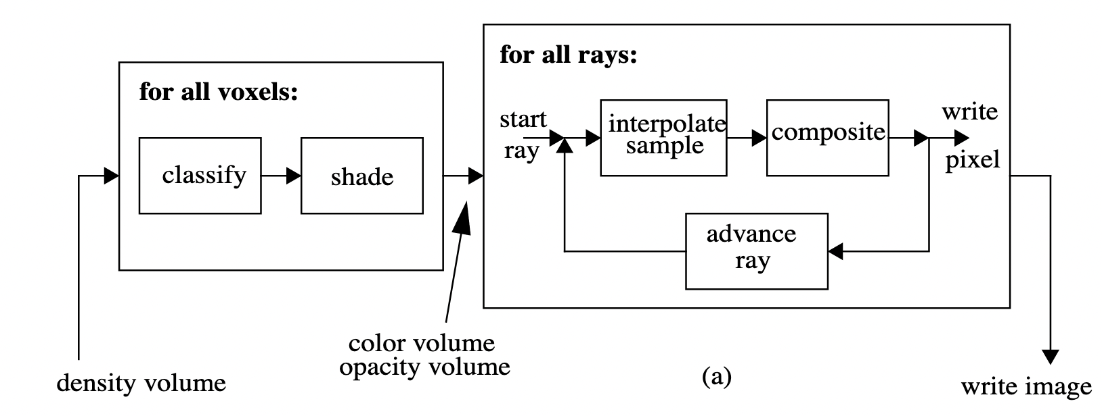
Types of Volume Rendering Pipelines
Pre-shaded pipeline
Classify and shade the data first and then perform ray casting and compositing
Color and opacity values are interpolated
Pre-shaded pipeline

Slide 5
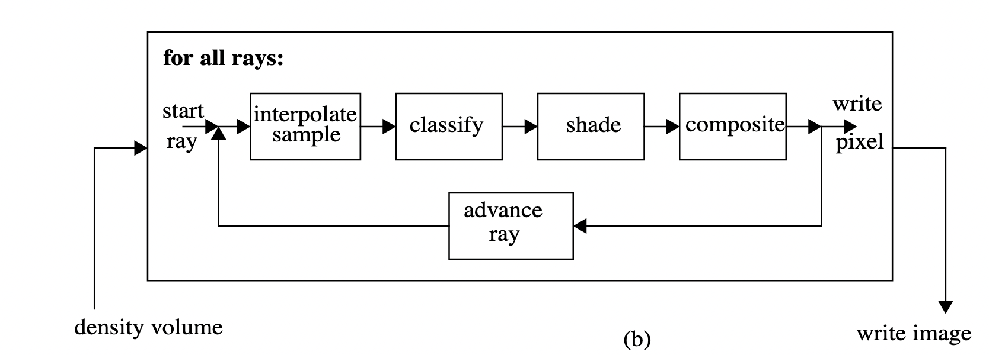
Types of Volume Rendering Pipelines
Pre-shaded pipeline
Classify and shade the data first and then perform ray casting and compositing
Color and opacity values are interpolated
Post-shaded pipeline
Directly ray cast into the data, get data values at query location and use transfer function to shade and then composite
Data value are interpolated
Pre-shaded pipeline
Post-shaded pipeline

Slide 6
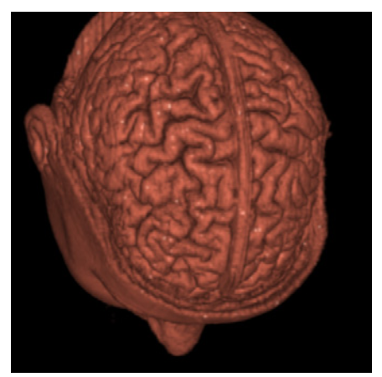
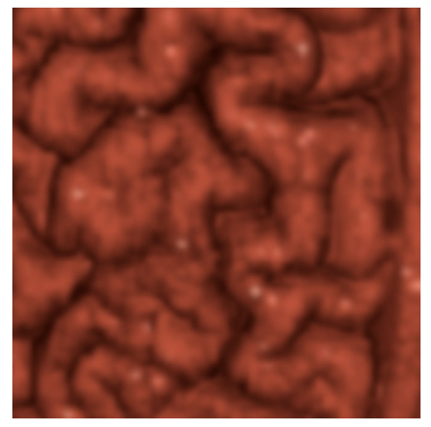
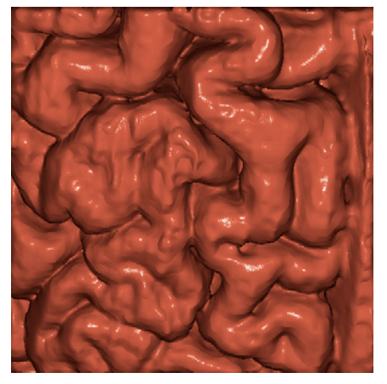
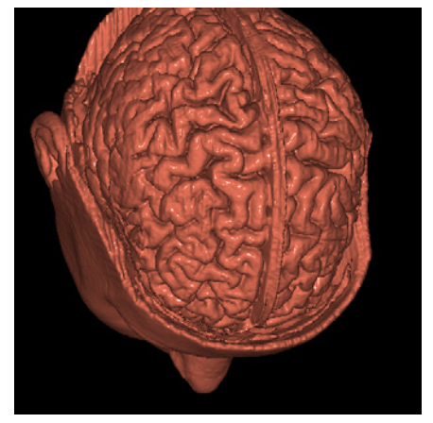
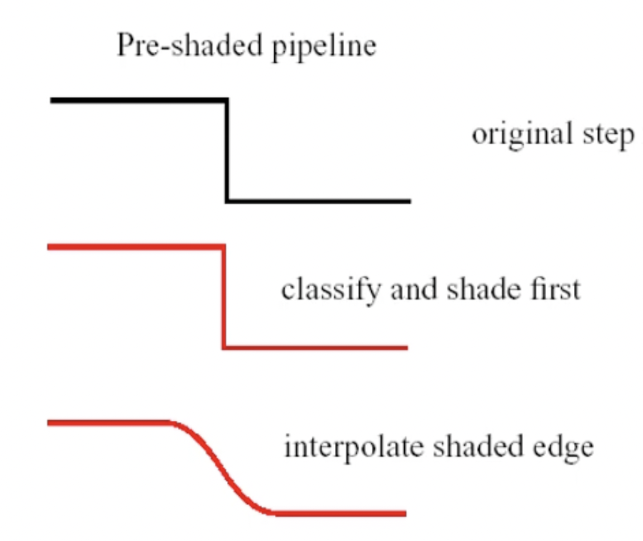
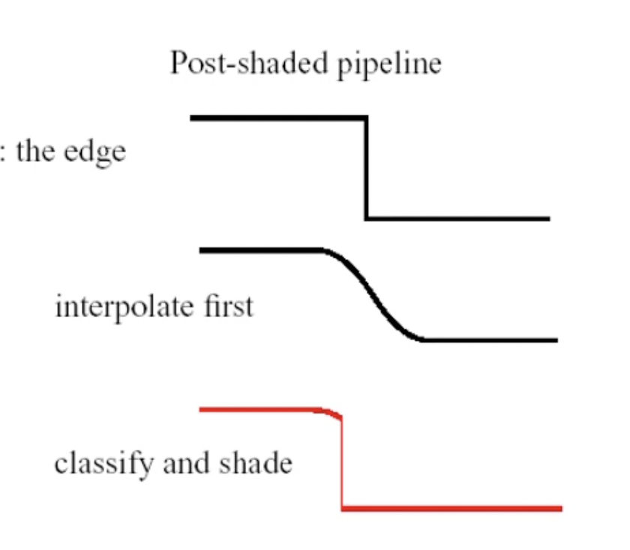
Pre-shaded vs Post-shaded Volume Rendering
Blurry edge
Sharp edge

Slide 7
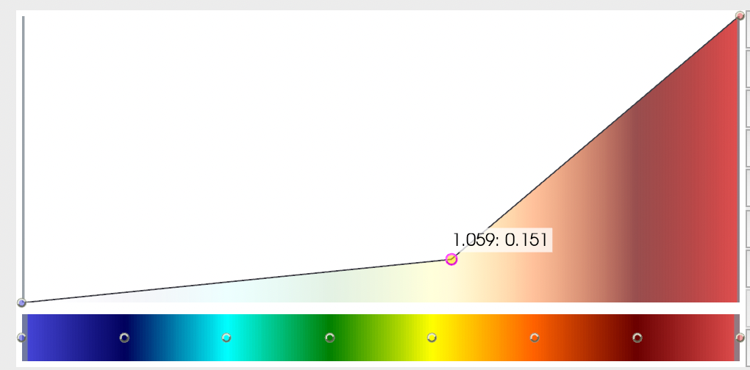
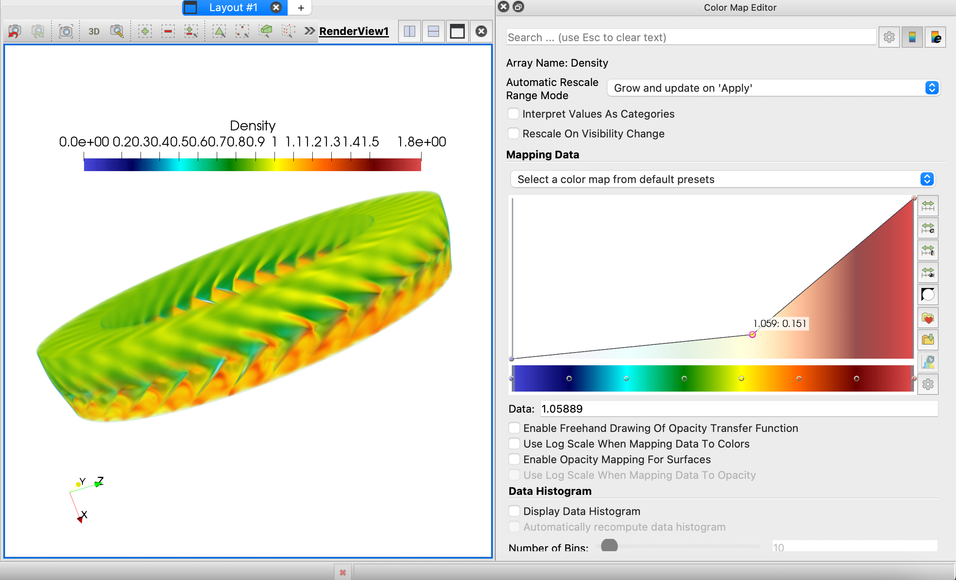
Transfer Function
Determines what color & opacity a sample value should have
Input: an interpolated data value
Output: a color and opacity (RGBA)
1
Transfer Function
0
Scalar data value color scale

Slide 8
Transfer Function
At the simplest form, we can think of four 1D transfer functions
Red, Green, Blue, Alpha (opacity)
1.0
1.0
1.0
1.0
Intensity of Red
Intensity of Green
Intensity of Blue
Opacity
Data value
Data value
Data value
Data value

Slide 9
Transfer Function
At the simplest form, we can think of four 1D transfer functions
Red, Green, Blue, Alpha (opacity)
1.0
1.0
1.0
1.0
Intensity of Red
Intensity of Green
Intensity of Blue
Opacity
Data value
Data value
Data value
Data value
Can you design an opacity transfer function for showing an Isosurface?

Slide 10
Transfer Function
At the simplest form, we can think of four 1D transfer functions
Red, Green, Blue, Alpha (opacity)
1.0
1.0
1.0
1.0
Intensity of Red
Intensity of Green
Intensity of Blue
Opacity
Data value
Data value
Data value
Data value

Slide 11
Classification and Shading
We have already seen that shading is the process of assigning color values to data points considering parameters of the rendering system
Classification: Mapping data values to opacities
Region of interest → High Opacity so that clearly seen
Unimportant regions → Full or semi transparent
1.0
1.0
Opacity
Opacity
0.0
Data value
0.0
Data value
V = value of interest
V1
V2

Slide 12
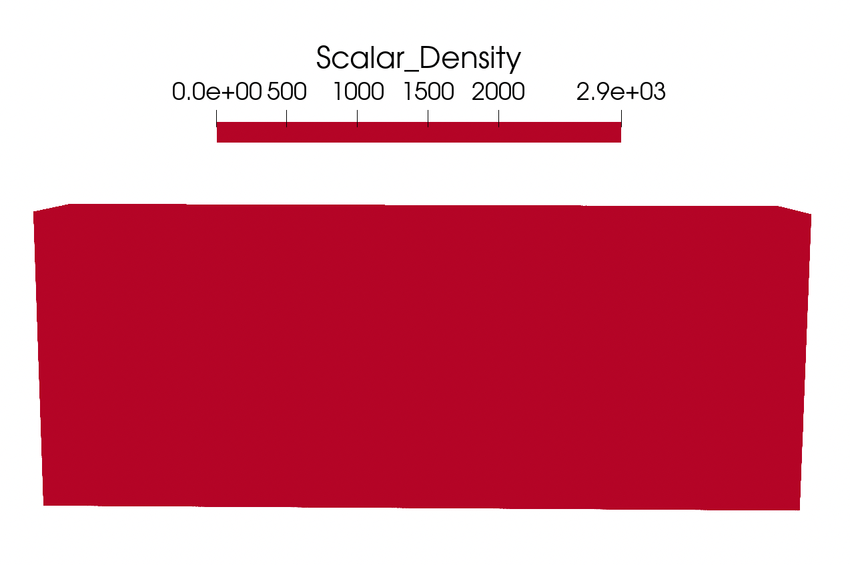
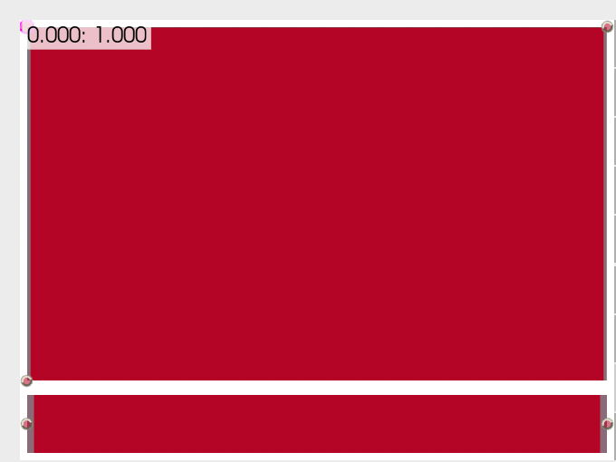
Classification: Color + Opacity Transfer Function
Distinguish between different materials or features in the data
Single color for all data values and all data values have opacity = 1.0

Slide 13
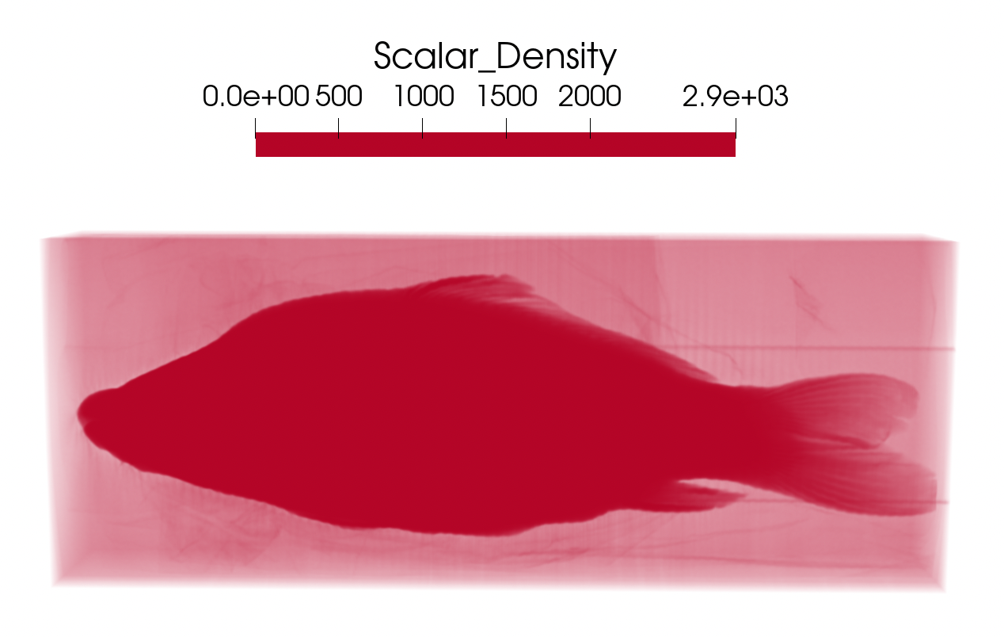
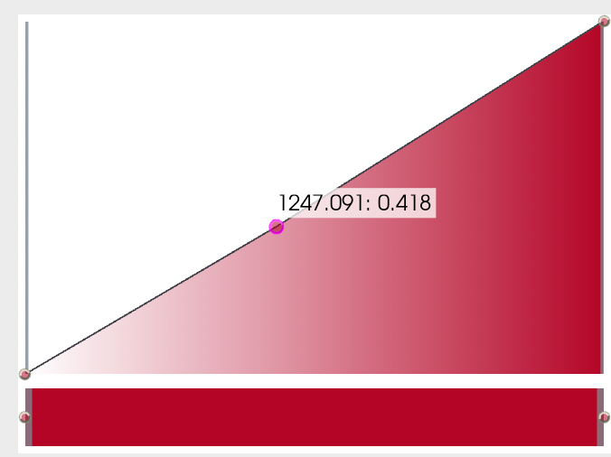
Classification: Color + Opacity Transfer Function
Distinguish between different materials or features in the data
Set opacity function as a ramp function, shows some structure inside

Slide 14
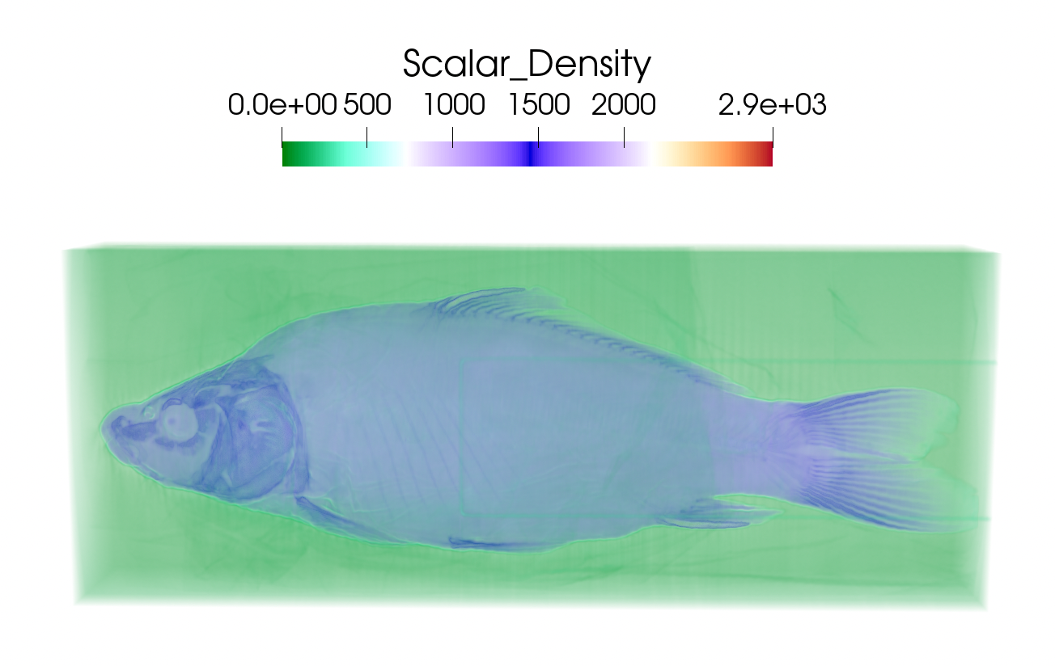
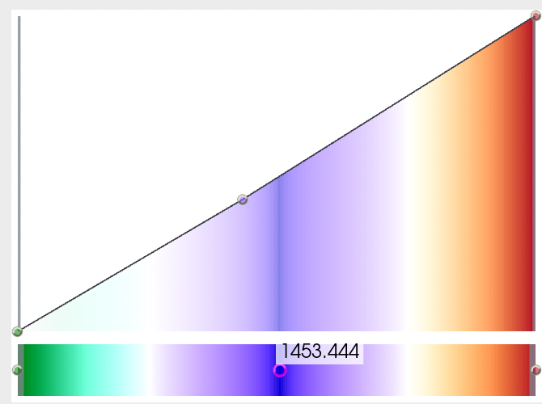
Classification: Color + Opacity Transfer Function
Distinguish between different materials or features in the data
Add two more colors in the color transfer function, fish is blue, background is green

Slide 15
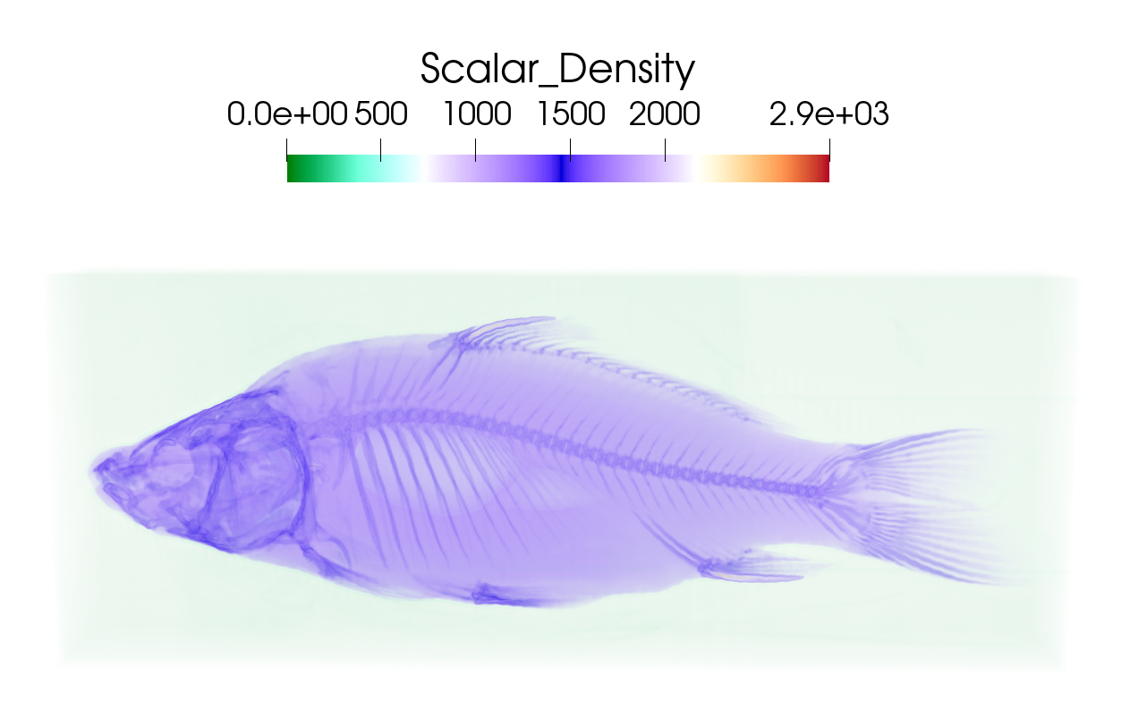
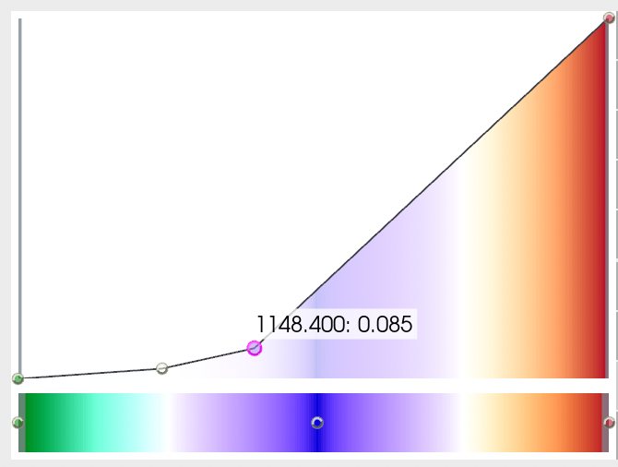
Classification: Color + Opacity Transfer Function
Distinguish between different materials or features in the data
Modified opacity transfer function to remove some of the background

Slide 16
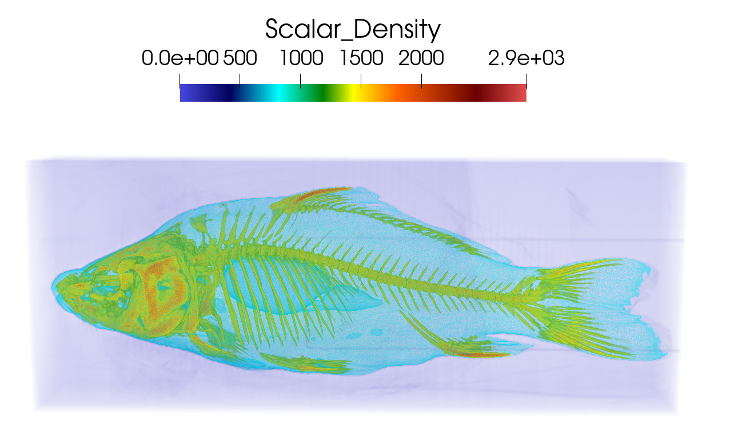
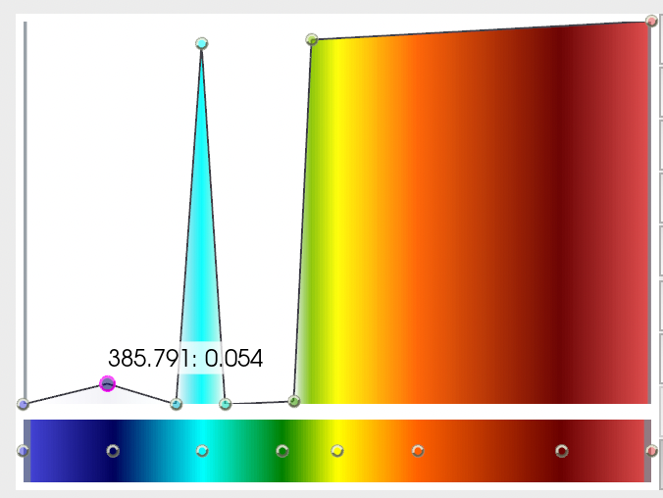
Classification: Color + Opacity Transfer Function
Distinguish between different materials or features in the data
Use a different color transfer function and try to engineer a more effective opacity function

Slide 17
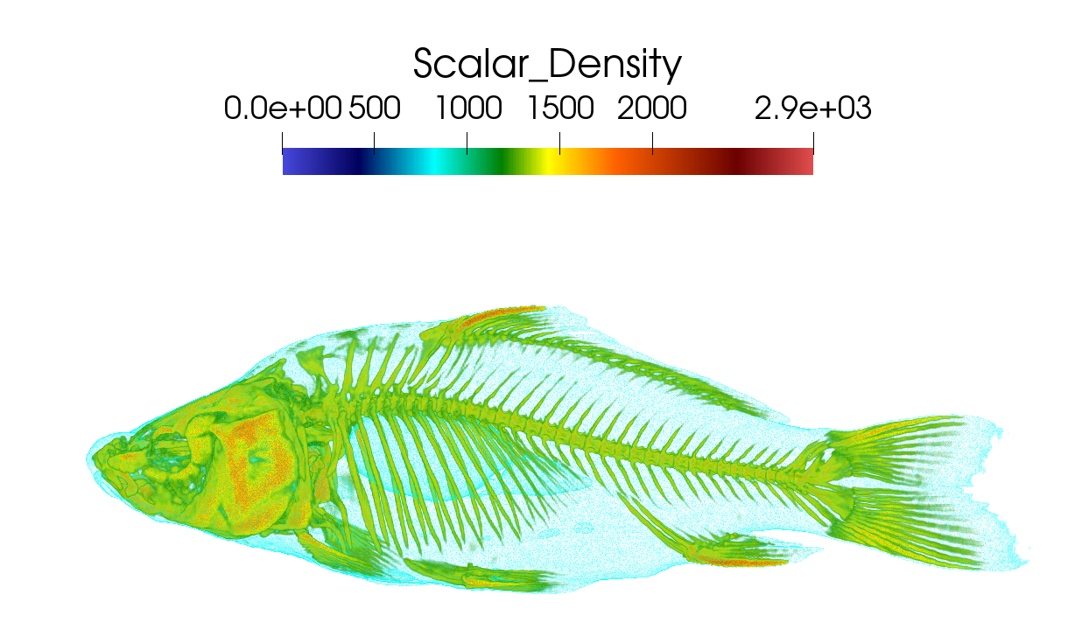
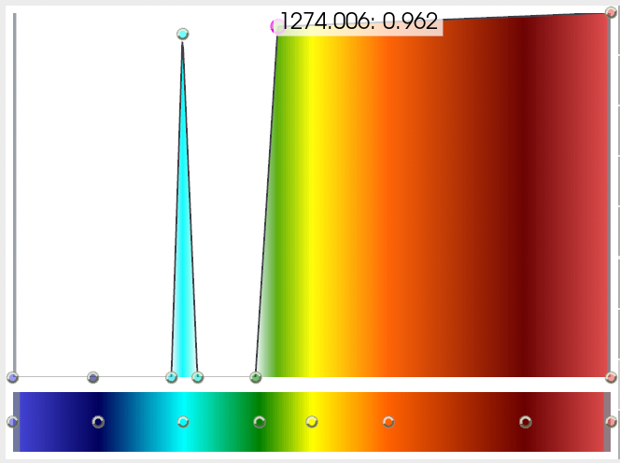
Classification: Color + Opacity Transfer Function
Distinguish between different materials or features in the data
Change the opacity function to remove the background and the fish is seen clearly

Slide 18
Transfer Function Design
Goal:
Use transfer functions to show salient features from the data set and deemphasize the unimportant data

Slide 19
Transfer Function Design
Goal:
Use transfer functions to show salient features from the data set and deemphasize the unimportant data
Challenges:
Without knowing what data values correspond to important data values, how do we design a good transfer function?
A small difference in transfer function can change the visualization drastically
Lots of manual tweaking might be required!

Slide 20
Transfer Function Design
Goal:
Use transfer functions to show salient features from the data set and deemphasize the unimportant data
Challenges:
Without knowing what data values correspond to important data values, how do we design a good transfer function?
A small difference in transfer function can change the visualization drastically
Lots of manual tweaking might be required!
Need algorithms and strategies that can automatically analyze data design an effective transfer function given all possible transfer functions in the search space

Slide 21
Trail and Error + Domain Knowledge
Manually control colors for scalar values and try different opacity functions to find an optimal one
Use domain knowledge about the data set to guide the design process
E.g.: what range of values correspond to bone and skin?
Can take significant amount of time!

Slide 22
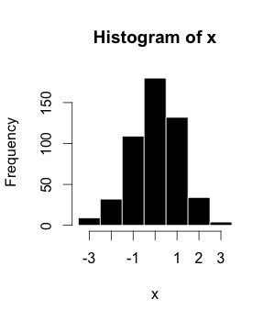
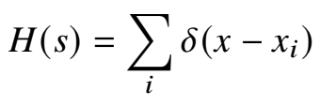
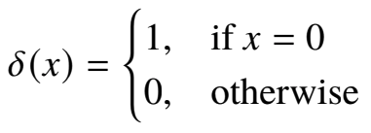
Histogram
Histogram: A histogram is an approximate representation of a statistical distribution. The area under a histogram can be normalized and used as a probability distribution function
Source: Wikipedia

Slide 23
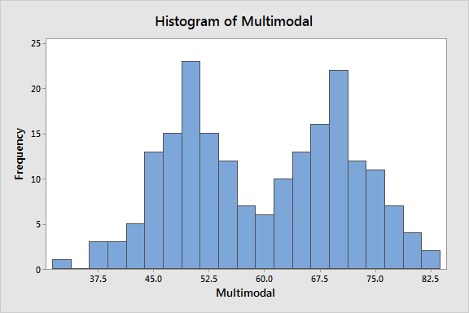
1D Histogram Assisted Transfer Function Design
Different features in data set can have different value ranges
Value clusters can be seen from histogram plots
Assign different colors for different clusters/histogram regions

Slide 24
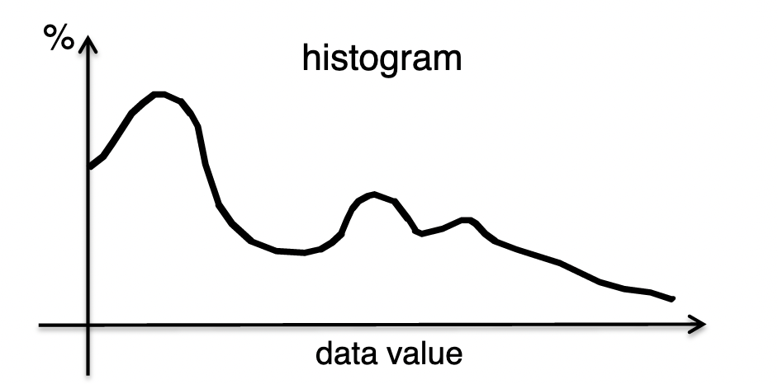
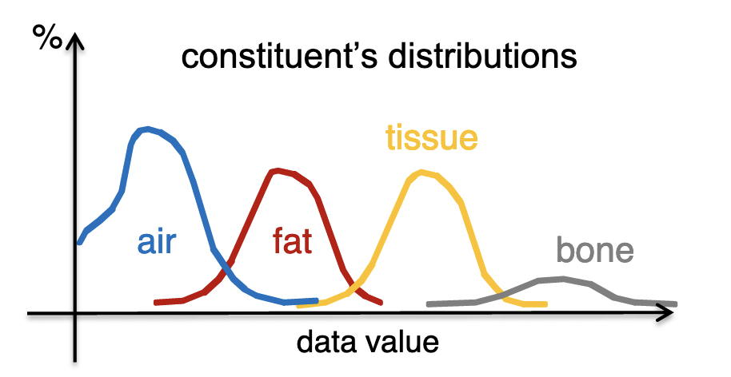
1D Histogram Assisted Transfer Function Design
Different features in data set can have different value ranges
Value clusters can be seen from histogram plots
Assign different colors for different clusters/histogram regions

Slide 25
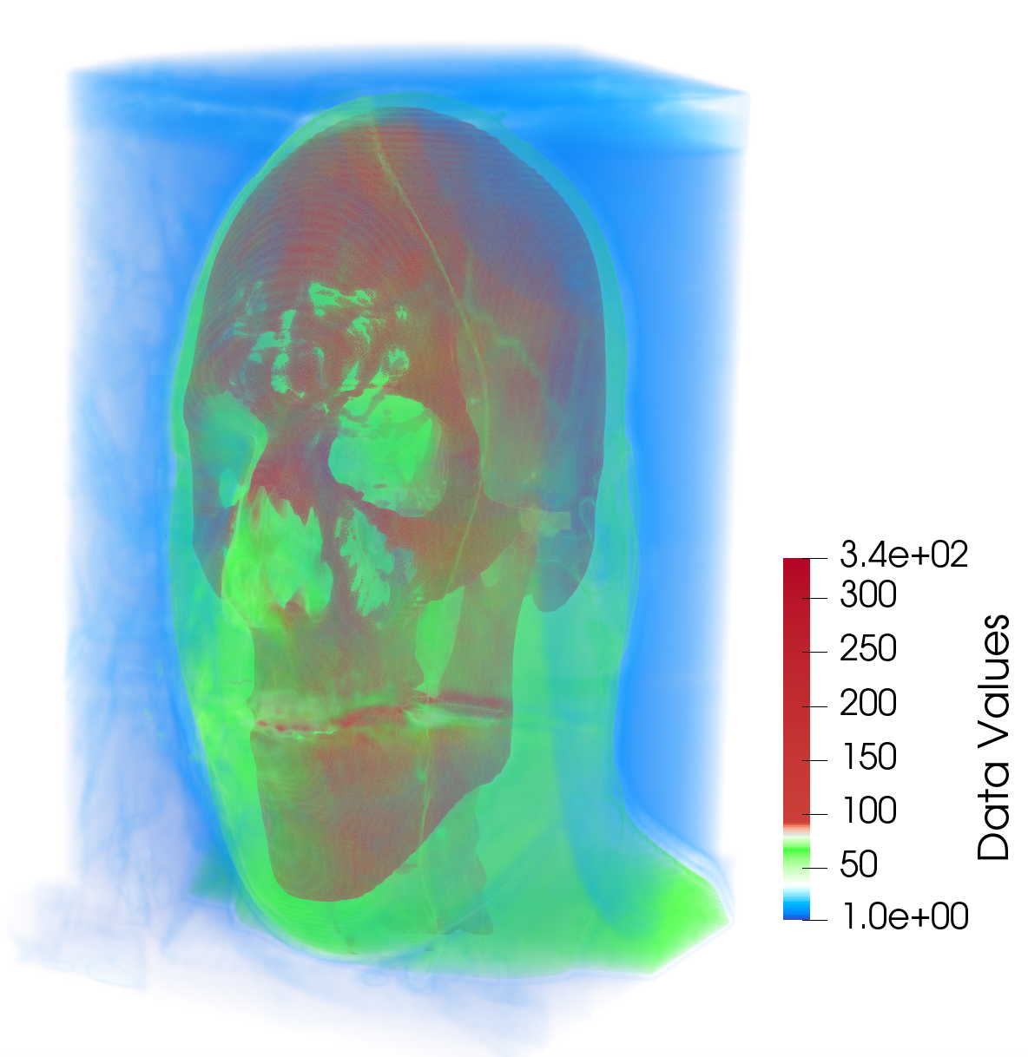
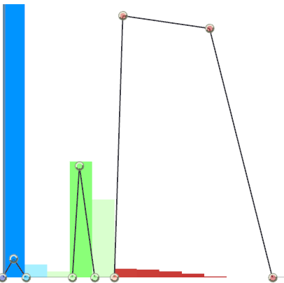
1D Histogram Assisted Transfer Function Design
Different features in data set can have different value ranges
Value clusters can be seen from histogram plots
Assign different colors for different clusters/histogram regions
Opacity Transfer Function with Histogram
Opacity
Data Values

Slide 26
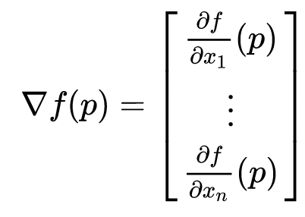
Multi-dimensional Transfer Function
Use the gradient information of the data to design a better transfer function that can highlight boundaries clearly
Distinct features/materials have roughly constant data value
Data values transition smoothly from one material to the next
Gradient of f:

Slide 27

Multi-dimensional Transfer Function
Use the gradient information of the data to design a better transfer function that can highlight boundaries clearly
Distinct features/materials have roughly constant data value
Data values transition smoothly from one material to the next
Multidimensional Transfer Functions for Interactive Volume Rendering, TVCG 2002

Slide 28
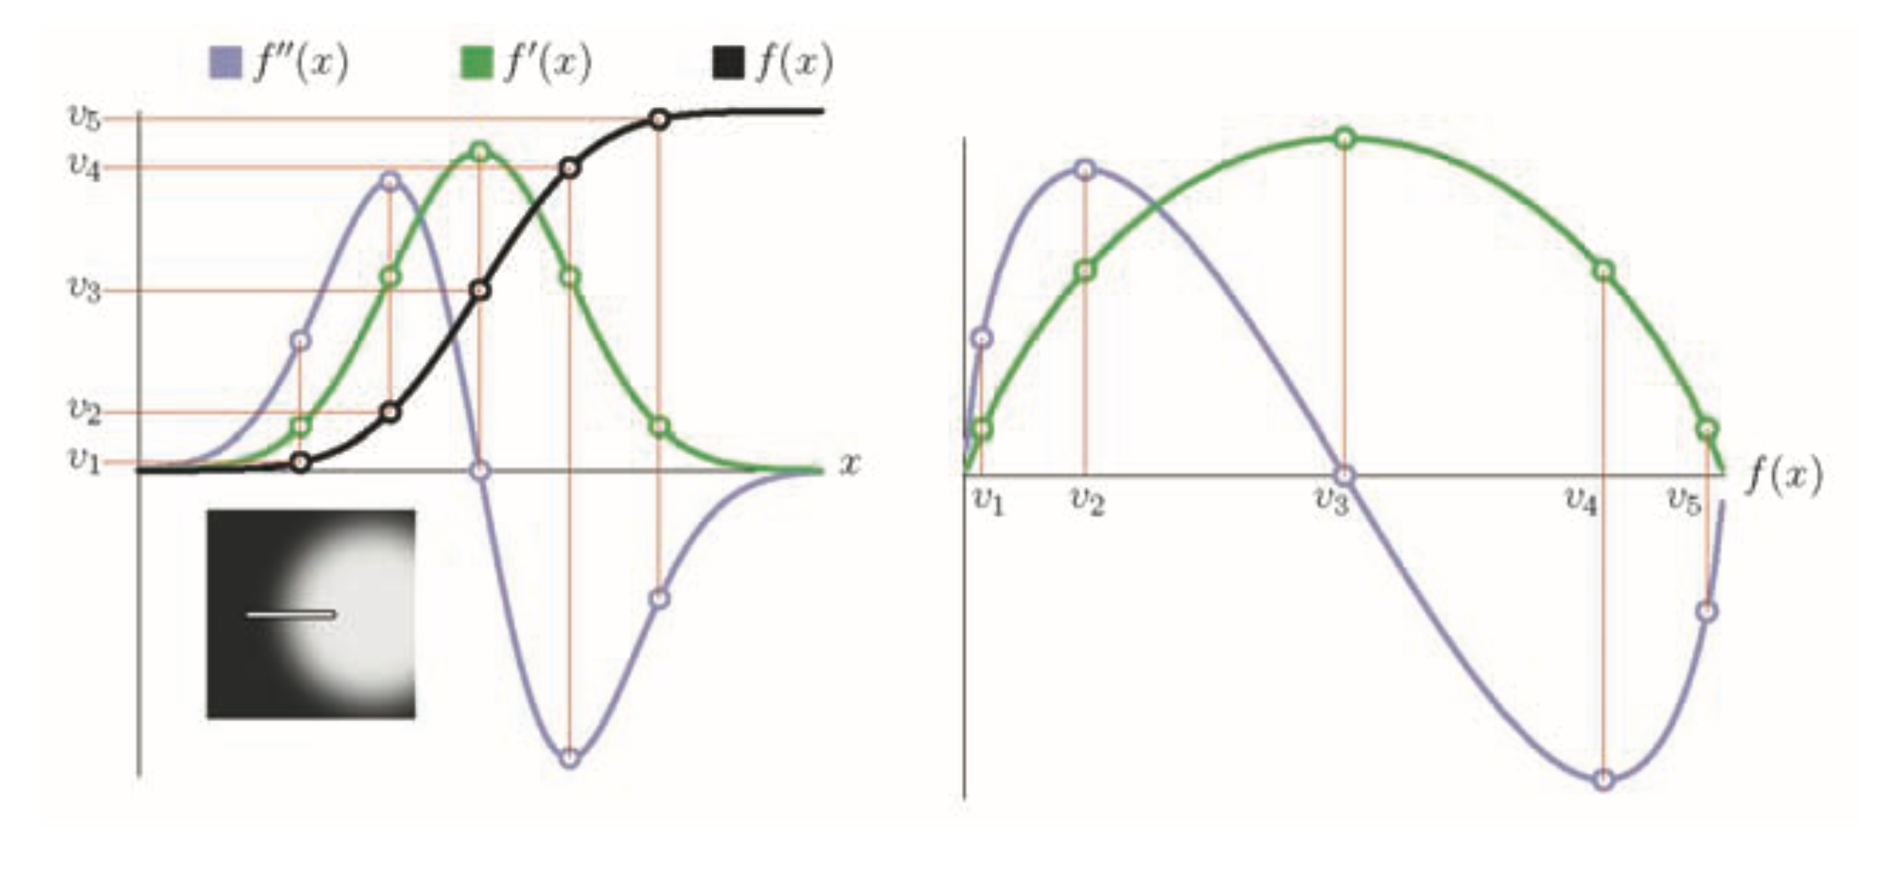
Multi-dimensional Transfer Function
Use the gradient information of the data to design a better transfer function that can highlight boundaries clearly
Distinct features/materials have roughly constant data value
Data values transition smoothly from one material to the next
Relationships between f, f’, f’’ in an ideal boundary
Multidimensional Transfer Functions for Interactive Volume Rendering, TVCG 2002

Slide 29
Multi-dimensional Transfer Function
Use the gradient information of the data to design a better transfer function that can highlight boundaries clearly
Distinct features/materials have roughly constant data value
Data values transition smoothly from one material to the next
Relationships between f, f’, f’’ in an ideal boundary
Multidimensional Transfer Functions for Interactive Volume Rendering, TVCG 2002

Slide 30
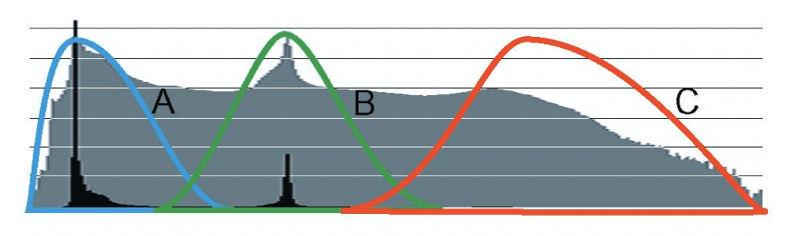
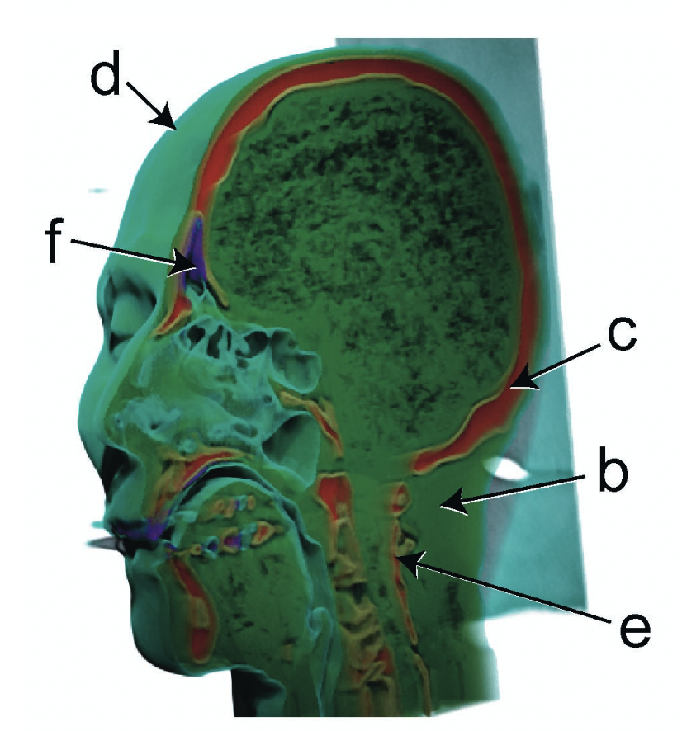
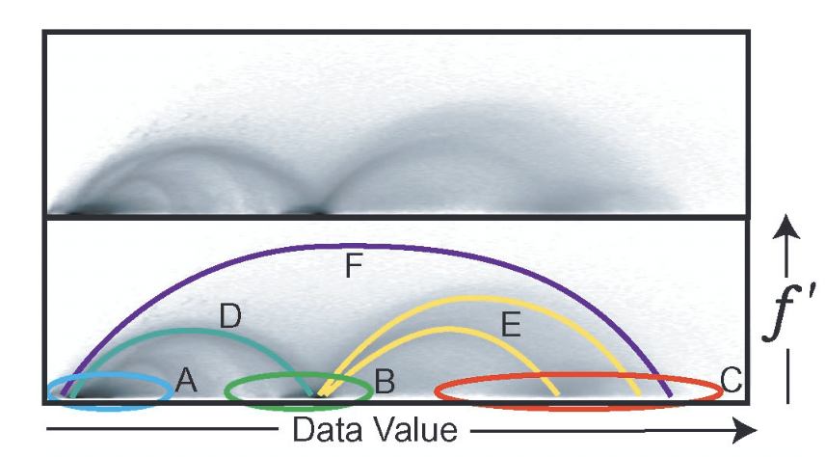
Multi-dimensional Transfer Function
a
A: Air
B: Tissue
C: Bone
D: Air and tissue boundary
E: Tissue and bone boundary
F: Air and bone boundary
1D Transfer Function
2D Transfer Function
X-axis: Data Value, Y-axis: Gradient
Multidimensional Transfer Functions for Interactive Volume Rendering, TVCG 2002

Slide 31
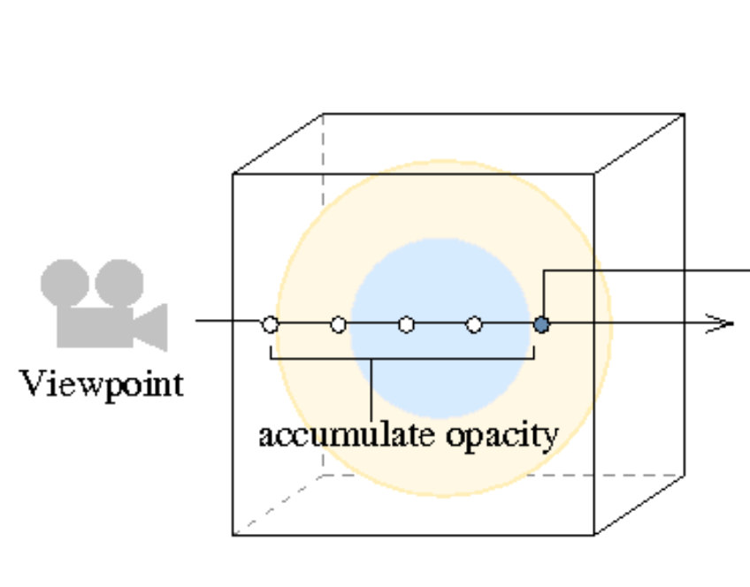
Visibility Histogram Guided Transfer Functions
A semi-automatic approach for generating opacity transfer function
The visibility of a sample refers to the contribution of a sample to the final image, in terms of opacity
Visibility depends on
Opacity of the sample
The viewpoint which affects the accumulated opacity in front of the sample
Visibility-Driven Transfer Functions, IEEE PacificVis

Slide 32
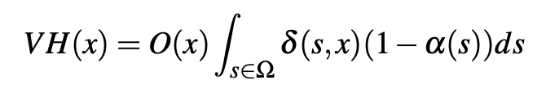
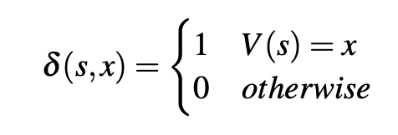
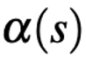
Visibility Histogram Guided Transfer Functions
Visibility Histogram: Distribution of the visibility function in relation to the domain values of the volume
x = data value at sample s
VH() = Visibility Histogram
O() = Opacity transfer function
V = Volume
= accumulated opacity in front of the sample s
Visibility-Driven Transfer Functions, IEEE PacificVis

Slide 33
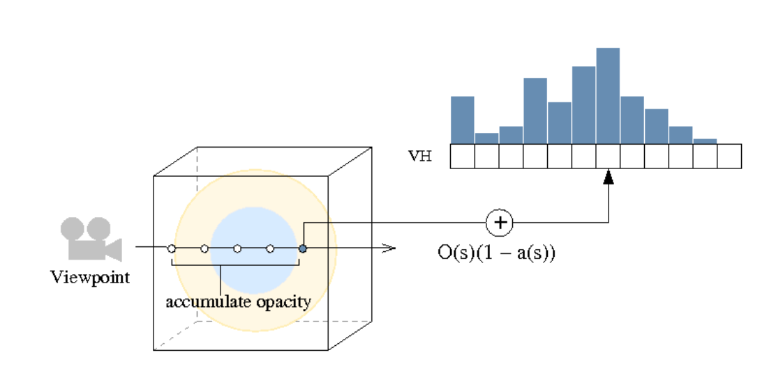
Visibility Histogram Guided Transfer Functions
Visibility Histogram: Distribution of the visibility function in relation to the domain values of the volume
Visibility Histogram
a(s) = accumulated opacity
Visibility-Driven Transfer Functions, IEEE PacificVis

Slide 34
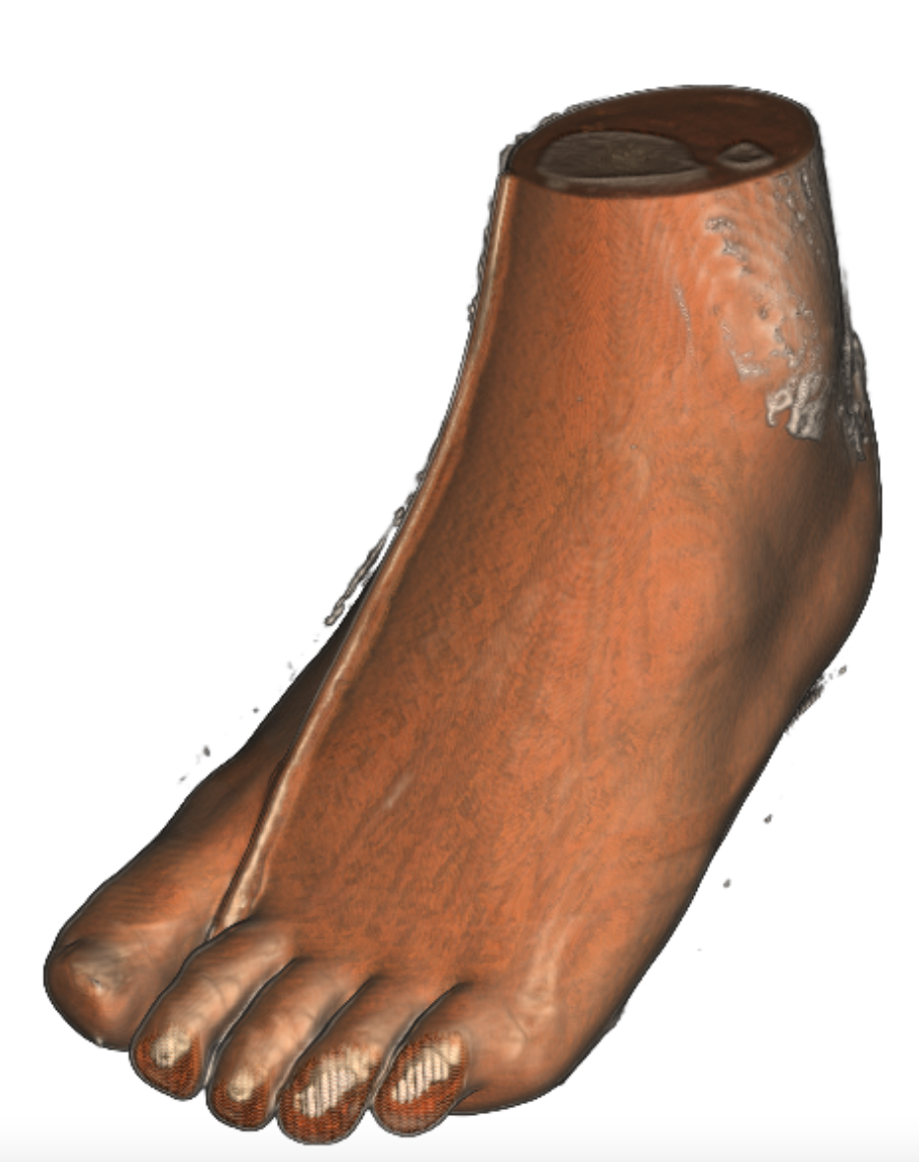
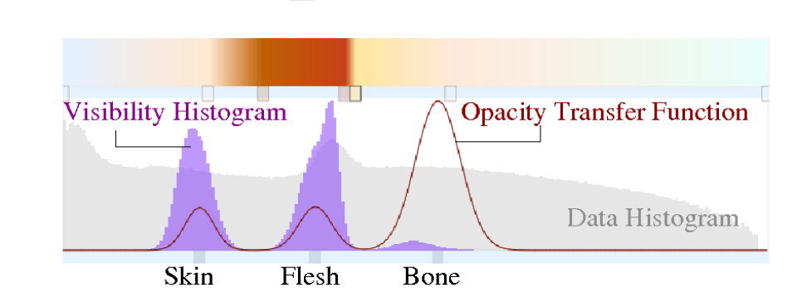
Visibility Histogram Guided Transfer Functions
Visibility Histogram: Distribution of the visibility function in relation to the domain values of the volume
User wants to see bones
with clarity
But we can’t see bons as flesh and skin is blocking it
Visibility Histogram can provide the guidance
Visibility-Driven Transfer Functions, IEEE PacificVis

Slide 35
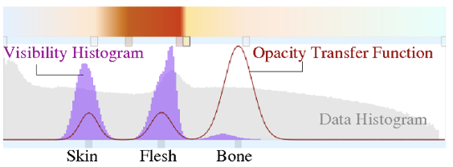
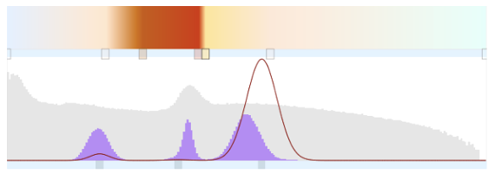
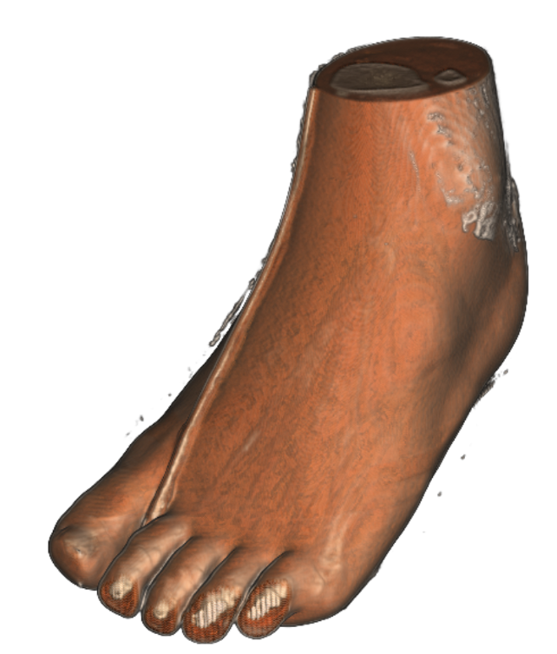
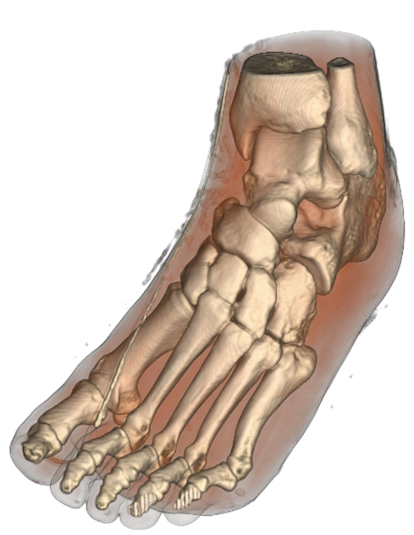
Visibility Histogram Guided Transfer Functions
Manual but there is Visibility
Histogram that provides guidance as to how to modify the opacity function
Can we do better?
Now, bones are clearly seen
Visibility-Driven Transfer Functions, IEEE PacificVis

Slide 36
Visibility Histogram Guided Transfer Functions
Semi-automatic transfer function design using Visibility Histogram
Use Optimization technique
selection of the best solution, with regard to some criterion, from some set of available alternatives by minimizing(maximizing) an energy function
Energy function considers characteristics of a good opacity transfer function
User satisfaction: minimize mismatch between user provided initial and computer transfer function
Visibility: maximize visibility of samples
Constraints: Constraints for opacity transfer function parameters
Visibility-Driven Transfer Functions, IEEE PacificVis

Slide 37
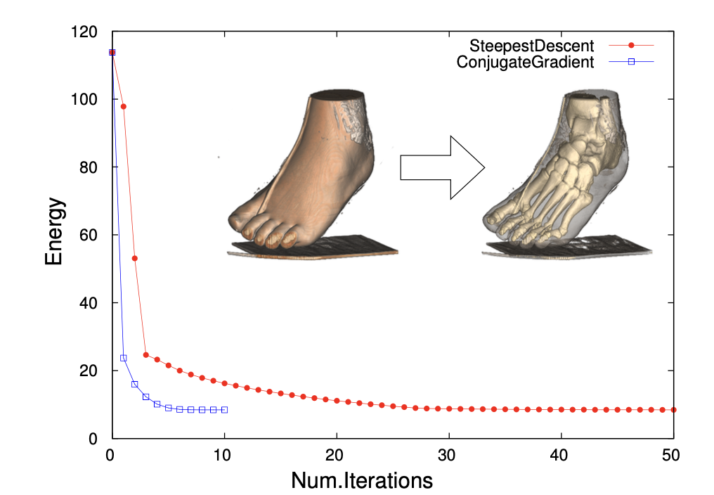
Visibility Histogram Guided Transfer Functions
Visibility-Driven Transfer Functions, IEEE PacificVis

